Slide 1
Digital Archival Tracker
Graduate directed project

Slide 2
Overview
Introduction
Problem Statement
Solution
Design
Progress
Conclusion

Slide 3
Introduction
Digital Archival Tracker is aimed at providing a streamlined solution for tracking archived files.
Developed by 3 teams :
User Interface
Service Integration
Database

Slide 4
Problem Statement
Complex and inconvenient tracking through manual entry of file information in to Excel.
Tedious and time consuming tracking process.
User has to read each Fixity report to identify information regarding each file.
No unification of entire tracking process.

Slide 5
High Level Solution
Unify tracking by automating the process.
Solution will read and understand Fixity reports.
Present Fixity report data in a clear, understandable fashion.
Solution will also provide ability to read, manipulate and save existing and new Excel sheets for AIP Records.

Slide 6
Preliminary Technologies User Interface
WPF – Windows Presentation Foundation Framework
Next-generation presentation system - building Windows client applications - visually stunning user experiences.
Create a wide range of standalone and browser-hosted applications.
Extremely flexible - re design your own controls without buying new controls.
Tools – Visual Studio 2015 Enterprise Edition.
API – Provided by Service Integration Team.

Slide 7
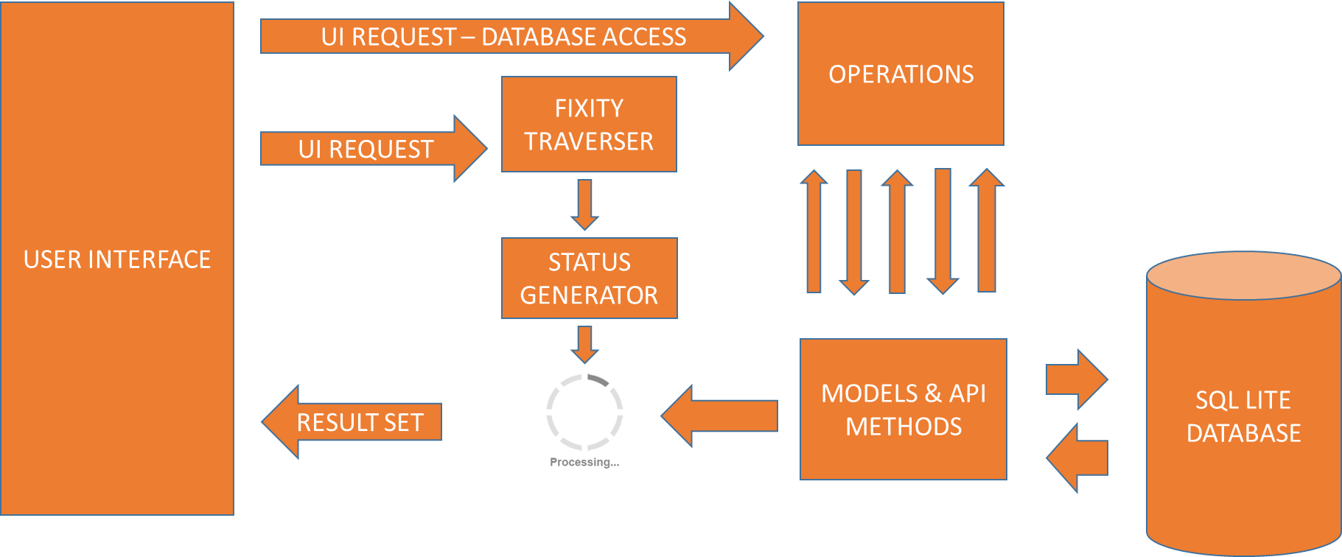
Preliminary Implementation Service Integration

Slide 8
Preliminary Technologies Database
SQL Lite Database
No prior SQL Lite Database server installation required.
There is no "setup" procedure.
There is no server process that needs to be started, stopped, or configured.
Programs that use SQLite require no administrative support for setting up the database engine before they are run.
Any program that is able to access the disk is able to use an SQLite database.

Slide 9
Preliminary Technologies Database - Continued
MVC- Model, View & Controller
MVC framework is an alternative to .NET web forms pattern for creating web application.
It is traditionally used for desktop GUIs.
Model manages data, logic & rules of application.
View is the output representation.
Controller converts input to command for model or view.

Slide 10
Database Interaction Design

Slide 11
Result – Looks beautiful
MainBag
AIP_Record
Upload_Info
mainBagId
------------------------
- mainBagName
- timeStamp
AIPRecordID
---------------------------------
aipName
receivedByArchivist
- normalized
ongoingPreserveFile
- mainBagID
uploadInfoID
----------------------------------
- bagged
aiped
duraCloud
blackExternalHDD
redExternalHDD
firstFixityCheckBack
firstFixityCheckRed
AIPRecordID
PK
PK
PK
FK
Comments
FK
Quarters
commentID
-----------------------------
commentDescription
timestamp
aipRecordID
ReplyComments
PK
quarterID
------------------------
- quarter
upoadInfoID
year
replyCommentID
---------------------------------
- replyComment
- commentID
PK
PK
FK
FK
FK

Slide 12
Sample API Methods
createAIPRecord (AIPRecord aipRecordObject){
INSERT INTO AIP_Record VALUES (value1, value2, value3 ...);
}
getLatestFixityReportName(DateTime timestamp){
SELECT column_name FROM MainBag WHERE timestamp < currenttimestamp;
}
string getComment(int aipRecordID){
SELECT commentDescription FROM Comments WHERE aipRecordID=recordID;
}
removeReply(int replyCommentID){
DELETE FROM Reply_Comments WHERE replyCommentID = replyCommentID;
}

Slide 13
UI Demo

Slide 14
Service Integration Demo

Slide 15
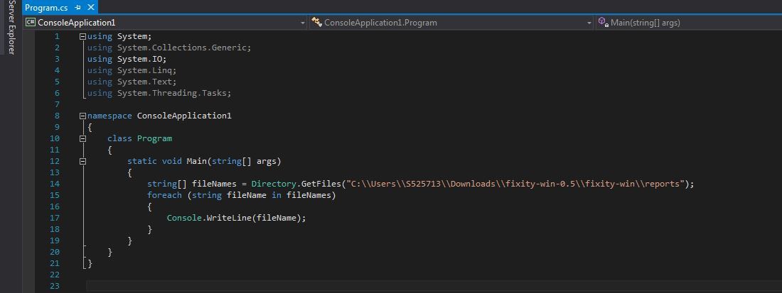
Fixity Report Folder Traversal

Slide 16
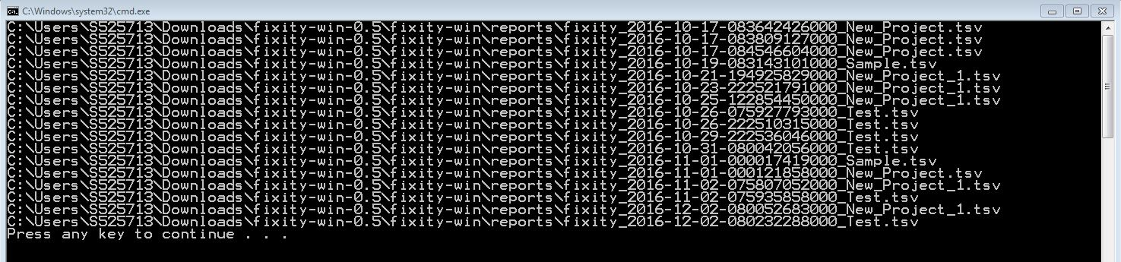
Output

Slide 17
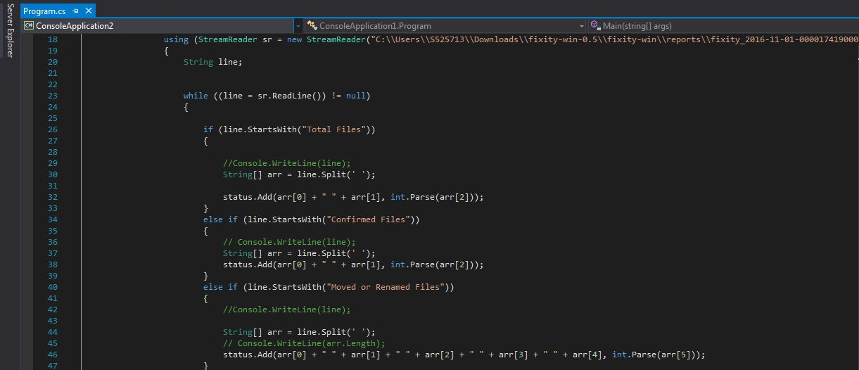
TSV Status Generator

Slide 18
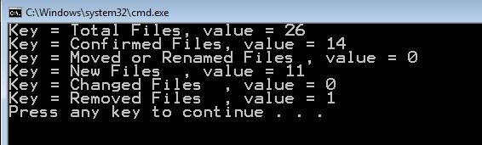
Output

Slide 19
Database Demo

Slide 20
Progress
Searches chosen folder for Fixity reports and identifies them.
Retrieved status of each Fixity report in the Fixity report folder.
The database design is finalized.
The team is able to perform CRUD operations in a dummy Windows Form application with SQL Lite as back end.

Slide 21
Conclusion
Requirement gathering and documentation.
Prototype enabled design and development.
Built for Windows platform to solve user’s current inconvenience of tracking multiple files.
Reading, understanding and displaying Fixity reports in clear and understandable fashion.
Editing and saving AIP Reports to user’s system for future reference.
All this in one simple but powerful solution.

